Slide 1


ARESTIN is a trademark of Bausch Health Companies Inc. or its affiliates. © 2020 Bausch Health Companies Inc. or its affiliates
201
PERIODONTAL CASE
DEVELOPMENT AND
PATIENT SELECTION
REINFORCING APPROPRIATE USE OF ARESTIN AND PREPARING A PATIENT’S
CASE STUDY
Please see Important Safety Information in this presentation and full Prescribing Information available at this presentation
Notes:
This presentation is intended to provide information about how to incorporate ARESTIN into treatment plans for appropriate periodontal patients. It will also educate students about periodontal case development, including the vital components to include in a case presentation.

Slide 2
Overview
Welcome to ARESTIN 201. Having completed ARESTIN 101, you should understand :
The features of comprehensive periodontal treatment, including ARESTIN® (minocycline HCl) Microspheres, 1 mg + as an adjunct to non-surgical periodontal therapy
Important safety information, contraindications, and precautions of ARESTIN® (minocycline HCl) Microspheres, 1 mg ®
How and when it is appropriate to use ARESTIN® (minocycline HCl) Microspheres, 1 mg
Using good patient communication to educate the patient on the importance of periodontal treatment
Notes:
Let’s begin ARESTIN 201. This presentation will help prepare you to recognize appropriate patients for comprehensive treatment that includes ARESTIN, develop a periodontal case study, and apply diagnostic guidelines in a clinical setting.
This will prepare you for some of the real-world challenges you’ll be faced with as a dental healthcare professional who treats adult patients with periodontal disease.

Slide 3
Overview (continued)
ARESTIN 201 will help prepare you to:
Identify appropriate patients for periodontal therapy that includes ARESTIN® (minocycline HCl) Microspheres, 1 mg as adjunct to scaling and root planing (SRP) procedures
Develop a periodontal case study
Apply diagnostic guidelines in a clinical setting
Notes:
Read Slide

Slide 4
Objectives
First, the ARESTIN 201 presentation and clinical assignment will prepare you to:
Discuss the 2017 AAP Classification guidelines for Periodontal Diseases and Conditions
Develop a comprehensive treatment plan for a periodontal patient
Recognize when to refer to the periodontist
Create a periodontal case study following the ARESTIN® (minocycline HCl) Microspheres, 1 mg 201 Periodontal
Case Study Content Guidelines¹
Demonstrate competency using ARESTIN® (minocycline HCl) Microspheres, 1 mg
Compare treatment outcomes with SRP alone vs SRP + ARESTIN® (minocycline HCl) Microspheres, 1 mg
REFERENCE: 1. Francis B. Case Development, Documentation, and Presentation. In: Mosby’s Dental Hygiene: Concepts, Cases and Competencies. 2nd ed. St Louis, MO: Elsevier; 2008:430-439. Adapted and reprinted with permission from Elsevier.
Notes:
To begin your clinical assignment, we are going to discuss 2017 AAP Classification of periodontal disease and conditions and talk about CASES when a patient referral to a periodontist should be considered. Next, we will develop a treatment plan for a periodontal patient, which will help you, when the time comes to create a case study of your own for a periodontal patient.
You will demonstrate competency in placing ARESTIN in a clinical setting. Finally, you will be asked to share the outcomes of treatment as a whole and were there added treatment outcomes when Arestin is used in conjunction with SRP

Slide 5
ARESTIN® (minocycline HCl) Microspheres, 1 mg
Important Safety Information
ARESTIN is contraindicated in any patient who has a known sensitivity to minocycline or tetracyclines. Hypersensitivity reactions and hypersensitivity syndrome that included, but were not limited to anaphylaxis, anaphylactoid reaction, angioneurotic edema, urticaria, rash, eosinophilia, and one or more of the following: hepatitis, pneumonitis, nephritis, myocarditis, and pericarditis may be present. Swelling of the face, pruritus, fever and lymphadenopathy have been reported with the use of ARESTIN. Some of these reactions were serious. Post-marketing cases of anaphylaxis and serious skin reactions such as Stevens Johnson syndrome and erythema multiforme have been reported with oral minocycline, as well as acute photosensitivity reactions.
THE USE OF DRUGS OF THE TETRACYCLINE CLASS DURING TOOTH DEVELOPMENT MAY CAUSE PERMANENT DISCOLORATION OF THE TEETH, AND THEREFORE SHOULD NOT BE USED IN CHILDREN OR IN PREGNANT OR NURSING WOMEN.
Notes:
Read slide.

Slide 6
ARESTIN® (minocycline HCl) Microspheres, 1 mg
Important Safety Information
Tetracyclines, including oral minocycline, have been associated with development of autoimmune syndromes including a lupus-like syndrome manifested by arthralgia, myalgia, rash, and swelling. Sporadic cases of serum sickness-like reaction have presented shortly after oral minocycline use, manifested by fever, rash, arthralgia, lymphadenopathy and malaise. In symptomatic patients, diagnostic tests should be performed and ARESTIN treatment discontinued.
The use of ARESTIN in an acutely abscessed periodontal pocket or for use in the regeneration of alveolar bone has not been studied.
Notes:
Read slide.

Slide 7
ARESTIN® (minocycline HCl) Microspheres, 1 mg
Important Safety Information
The safety and effectiveness of ARESTIN has not been established in immunocompromised patients or in those with coexistent oral candidiasis. Use with caution if there is a predisposition to oral candidiasis.
In clinical trials, the most frequently reported nondental treatment-emergent adverse events were headache, infection, flu syndrome, and pain.
To report SUSPECTED ADVERSE REACTIONS, contact Bausch Health US, LLC at 1-800-321-4576 or FDA at 1-800-FDA-1088 or www.fda.gov/medwatch.
Notes:
Read slide.

Slide 8

Periodontal Disease- Etiologic Factors
Is an infectious Inflammatory disease, driven by certain bacterial compositions in biofilms, initiating an inflammatory response.
Genetics and environmental and behavioral factors are involved in the development of the disease.
The most common chronic infection in the US is periodontal disease
The most characteristic feature of periodontitis is the activation of osteoclastogenesis and the destruction of alveolar bone
Könönen, E., Gursoy, M., & Gursoy, U. K. (2019). Periodontitis: A Multifaceted Disease of Tooth-Supporting Tissues. Journal of clinical medicine, 8(8), 1135. doi:10.3390/jcm8081135
Notes:
Periodontal disease in early or moderate stage, with a prevalence of 50% can easily be managed just as other diseases of the body. It is when the disease progresses to advanced stages, adding other contributing factors it can become harder to control and may lead to tooth loss and contribute to systemic diseases .

Slide 9
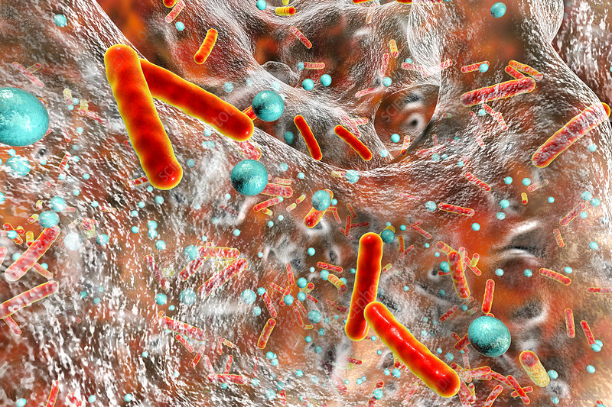
Oral Cavity Microbial Structure
Microbial species in the oral cavity can be planktonic (free floating) or incorporated in biofilms¹.
As many as 80% of pathogens that form biofilms are associated with persistent infections³.
Biofilms are dense mixtures of
organisms resistant to natural
antibodies and proteins that the
body uses to fight infection².
10 million bacteria in a 5 mm pocket
1 billion bacteria 10 mm+ pocket
500 bacterial strains identified in biofilm
1. Berger, D., Rakhamimova, A., Pollack, A., & Loewy, Z. (2018). Oral Biofilms: Development, Control, and Analysis. High-throughput, 7(3), 24. doi:10.3390/ht7030024. 2.Socransky SS, Haffajee AD. Dental biofilms: difficult therapeutic targets. Periodontol 2000 2002;28:12-55. 3. Control of Biofilm Formation: Antibiotics and Beyond, Ammar Algburi, Nicole, Comito, Dimitri Kashtanov, Leon M. T. Dicks, Michael L. Chikindas,M. Julia Pettinari, Editor,DOI: 10.1128/AEM.02508-16.
Notes:
Read Slide

Slide 10
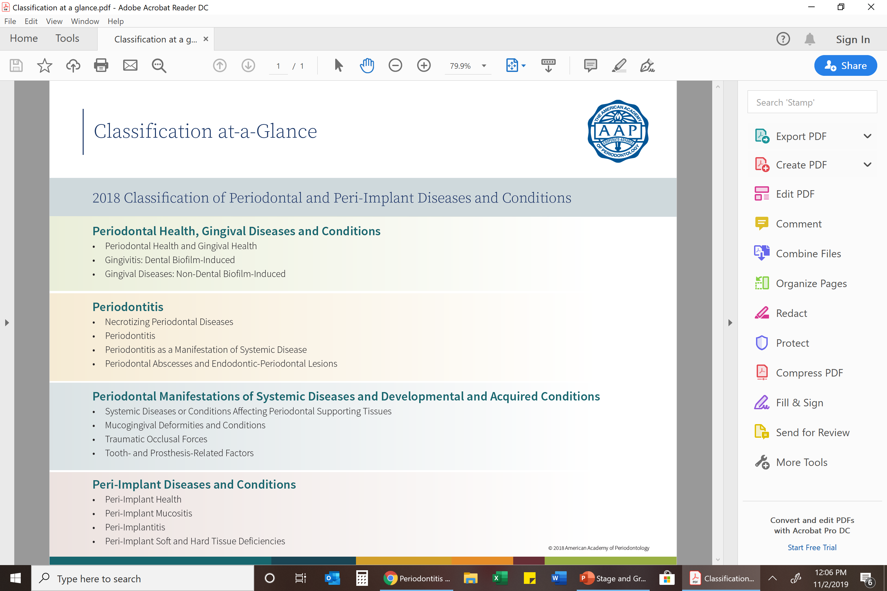
Notes:
This new classification system identifies three types of periodontal diseases and conditions along with several important subcategories:
Periodontal Health –
Gingivitis dental biofilm induced
Gingivitis –non biofilm induced –Genetic and development disorders,
In addition to periodontal disease and conditions, the system outlined in the Journal of Clinical Periodontology includes four new categories for peri-implant conditions and diseases. According to the American Academy of Implant Dentistry, 3 million people in the U.S. currently have dental implants and the number is increasing by 500,000 annually.
Periodontal disease-
Systemic- HIV- AID- Papillon Lefevre Syndrome-Neoplastic diseases.
Mucogingival- Lack of Gingiva- Decreased Vestibular Depth
Peri-implant health: A lack of visible inflammation and no bleeding upon probing
Peri-implant mucositis: Bleeding on probing and visible signs of inflammation
Peri-implantitis: Inflammation of peri-implant mucosa followed by progressive loss of surrounding bone
Hard and soft tissue implant site deficiencies: Deficiencies of the alveolar ridge caused by natural healing, extraction trauma, infections or a variety of other factors affecting hard and soft tissue

Slide 11
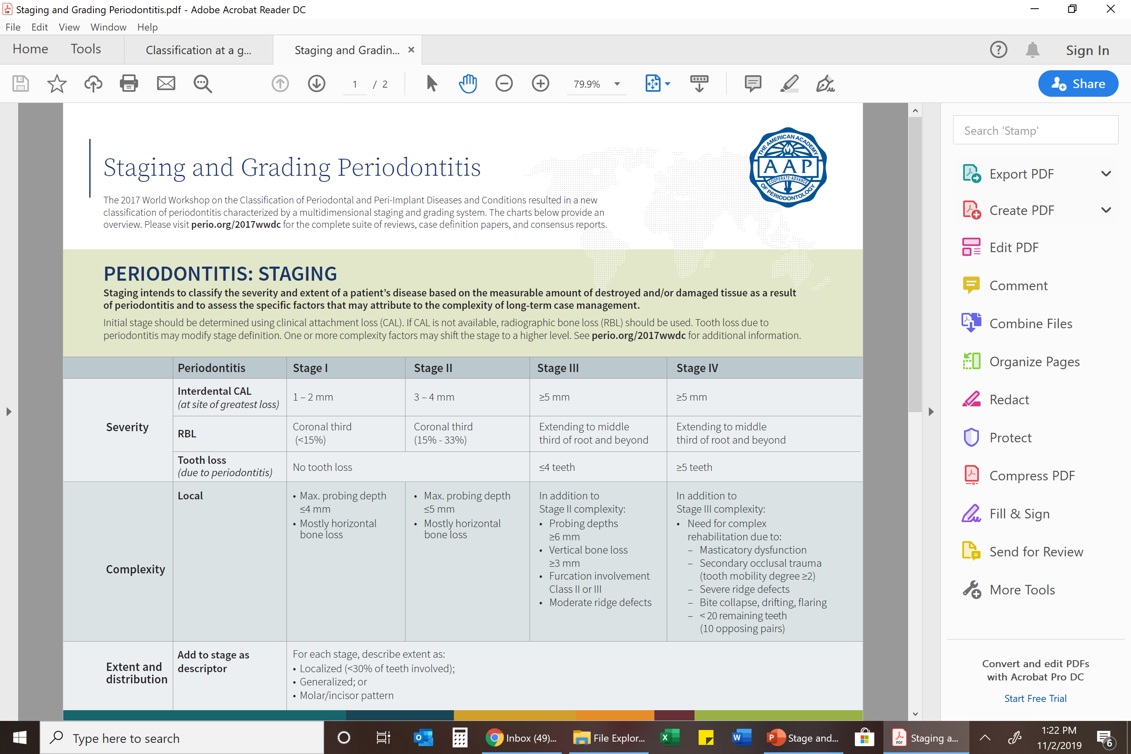
Notes:
Read slide

Slide 12
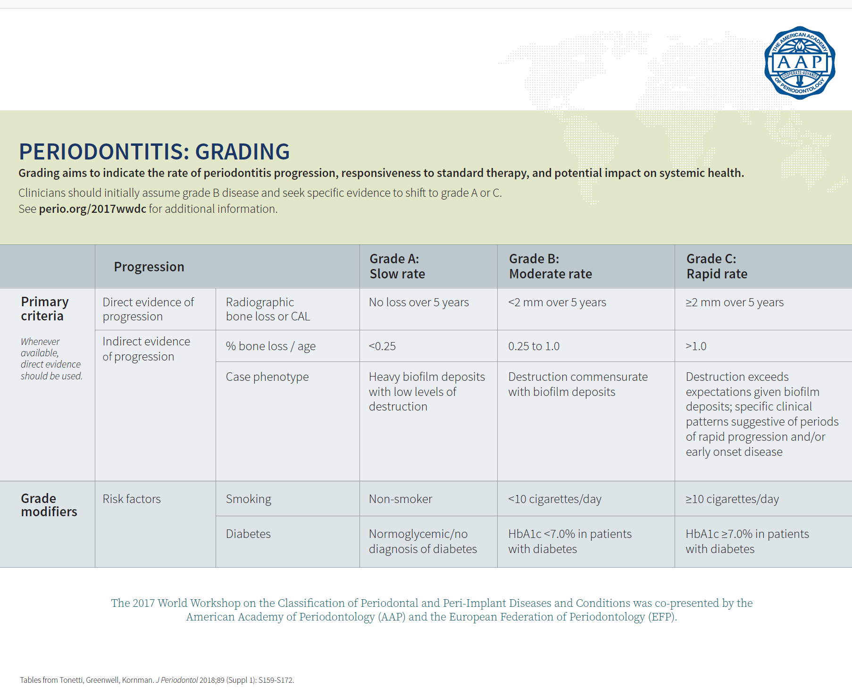
Notes:
Read Slide

Slide 13
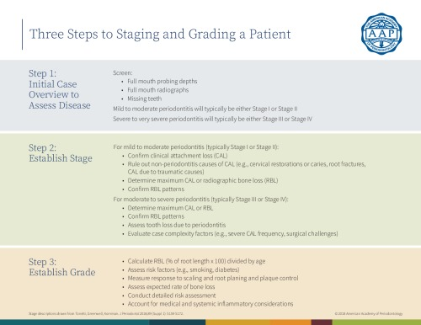
Notes:
Read Slide

Slide 14
Periodontal Diagnostic Guidelines
Due to the complexity of periodontal disease and its many risk factors, it is important to incorporate individual patient factors in development of a comprehensive case management program
Staging and grading guides the clinician to understand the severity, extent, and progression of each patient’s case of periodontal disease.
Periodontal Disease requires treatment at the first sign of disease and lifelong support for disease management
1.Caton, J, Armitage, G, Berglundh, T, et al. A new classification scheme for periodontal and peri‐implant diseases and conditions – Introduction and key changes from the 1999 classification. J Periodontol. 2018; 89( Suppl 1): S1– S8. https://doi.org/10.1002/JPER.18-0157
Notes:
Periodontal disease is a complex disease with multiple risk factors , the staging and grading system is designed to understand severity, extent, and prognosis of periodontal disease.
By using this tool, you can help ensure you are consistently identifying all stages of periodontal disease.

Slide 15
Referring to a Periodontist
Knowing when you refer a patient to a periodontist requires the development of clinical decision skills.
Reasons to consider a referral include:
  Advanced clinical attachment loss
  Periodontal disease associated with rare systemic conditions
  Gingival overgrowth and/or inflammatory hyperplasia
  Regenerative procedures for soft and hard tissue
  Periodontal surgery (ie, grafting, crown lengthening, laser treatment)
  Pre-prosthetic surgery
  Dental Implants
  Treatment needs are beyond your level of expertise
  You can also refer to American Academy of Periodontology. Comprehensive periodontal therapy: a statement by the American Academy of Periodontology. J Periodontol. 2011;82(7):943-9
  - Available at ArestinProfessional.com/arestin-student-access/for-students/reading-r
  esources
Sweeting LA, Davis K, Cobb CM. Periodontal treatment protocol (PTP) for the general dental practice. J Dent Hyg. 2008;82(suppl 3):16-26.
Notes:
Read Slide

Slide 16
Periodontal Case Study Development
The following slides provide criteria for the development of a periodontal case study on a clinical patient. Also included are:
Criteria for the selection of a patient who might be a candidate from the use of a locally administered antibiotic, such as ARESTIN® (minocycline HCl) Microspheres, 1 mg as an adjunct to non-surgical periodontal therapy
Information about post-treatment evaluation
Notes:
Read Slide

Slide 17
Periodontal Case Study Development (continued)
There are different ways to develop a periodontal case study. If your school has a preferred method, you should defer to it, but for this program we follow the guidelines found in:
National Board of Dental Hygiene Examiners Case Development Guide
By the Joint Commissioner on National Dental Examiners¹¹
Francis B. Case Development, Documentation, and Presentation. In: Mosby’s Dental Hygiene: Concepts, Cases and Competencies. 2nd ed. St Louis, MO: Elsevier; 2008:430-439²
https://www.ada.org/~/media/JCNDE/pdfs/nbdhe_case_guide.pdf?la=en
Reference is available for download at ArestinProfessional.com/arestin-student-access/for-students/reading-resources
Notes:
If your school has a preferred method to develop cases studies, you should defer to that. If not, this program uses guidelines that are available for download online at ArestinProfessional.com/201Reading.

Slide 18
Periodontal Case Study Development (continued)
Patient profile
Clinical data
Case Management
https://www.ada.org/~/media/JCNDE/pdfs/nbdhe_case_guide.pdf?la=en
Reference is available for download at ArestinProfessional.com/arestin-student-access/for-students/reading-resources
Notes:
Read slide:

Slide 19
Patient Profile
  Age, sex, and chief complaint
  Relevant physical characteristics
  Vitals, medical and dental history
  Relevant behavioral factors
    Diet, smoker, stress
  Relevant dental knowledge
  Chief concern
https://www.ada.org/~/media/JCNDE/pdfs/nbdhe_case_guide.pdf?la=en
Reference is available for download at ArestinProfessional.com/arestin-student-access/for-students/reading-resources
Notes:
Read slide:

Slide 20
Clinical Data
Clinical Data
  Dental charting of existing or needed care
  Comprehensive periodontal charting
    To include; probing depth and gingival margin deviations to assess the clinical attachment level, bleeding-suppuration, furcations and mobility. Identify stage and grade
  Intra-oral examination of tissue and other pathological concerns
  Diagnostic quality radiographs
  Intra/extra oral images, photographs
https://www.ada.org/~/media/JCNDE/pdfs/nbdhe_case_guide.pdf?la=en
Reference is available for download at ArestinProfessional.com/arestin-student-access/for-students/reading-resources
Notes:
Read Slide:
All information should be clear and concise. Cases should exclude irrelevant information

Slide 21
Clinical Data continued
  Occlusal classification
    Malocclusion
    Attrition
  Cast models
  Present oral health status
    plaque index
    calculus
https://www.ada.org/~/media/JCNDE/pdfs/nbdhe_case_guide.pdf?la=en
Reference is available for download at ArestinProfessional.com/arestin-student-access/for-students/reading-resources
21
Notes:
Read Slide:

Slide 22

Clinical Data, additional components may include
  Supplementary diagnostic testing ( salivary testing. HbA1C)
  pH testing
  Nutritional assessment
https://www.ada.org/~/media/JCNDE/pdfs/nbdhe_case_guide.pdf?la=en
Reference is available for download at ArestinProfessional.com/arestin-student-access/for-students/reading-resources
22
Notes:
Read Slide:
All information should be clear and concise. Cases should exclude irrelevant information

Slide 23

Case Management
The case management component includes 4 areas
Planning phase¹
Implementation¹
Post treatment evaluation (8-12 weeks)¹
Continued disease management²
  Setting disease management intervals
Francis B. Case Development, Documentation, and Presentation. In: Mosby’s Dental Hygiene: Concepts, Cases and Competencies. 2nd ed. St Louis, MO: Elsevier; 2008:430-439.
https://dimensionsofdentalhygiene.com/article/determining-recare-periodontal-maintenance/
.
23
Notes:
Read slide

Slide 24

Planning phase
Patient screening for case selection
Consideration of ARESTIN® (minocycline HCl) Microspheres, 1 mg indication and safety profile
Develop a detailed treatment plan with appointment times (this may be adjusted after a complete patient assessment)
Consider patient communication strategies
Informed consent
Desired outcomes
Disease management plan for patient and clinical care
Francis B. Case Development, Documentation, and Presentation. In: Mosby’s Dental Hygiene: Concepts, Cases and Competencies. 2nd ed. St Louis, MO: Elsevier; 2008:430-439.
Notes:
Patient selection should be a patient with either early or mod periodontitis and who has no contraindication for treatment with Arestin.
Developing a strategic treatment plan to include patient assessment, therapy, evaluation of therapy, patient communication and continued care and home care strategies is critical to a successful case study. It is Ok if this initial treatment plan needs to be altered.
Patient communication is key to any treatment plan and outcomes. The patient has to know what disease they have, who you can help to control further progression of the disease and what is expected of them for continued care. Informed consent forms need to be added to your plan prior to starting any treatment. Thinking about what the desired outcomes you may expect after treatment can be done at this phase but may change depending on the completed patient assessment and patient compliance. Developing a long term home care plan and continued periodontal maintenance regimen to help the patient understand that this disease may be managed but will always need continued care.

Slide 25

Implementation phases
(can be up to 4 appointments)
Complete comprehensive oral health assessment and risk assessment
Review treatment plan and make changes if needed.
Identify areas of ARESTIN® (minocycline HCl) Microspheres, 1 mg placement
Patient communication-obtain consent
Start initial therapy . Place Arestin as indicated in treatment plan
Develop customized home care plan based on comprehensive assessment
Set up evaluation appointment as needed
Francis B. Case Development, Documentation, and Presentation. In: Mosby’s Dental Hygiene: Concepts, Cases and Competencies. 2nd ed. St Louis, MO: Elsevier; 2008:430-439.
Notes:
Read Slide:
At this first appointment you will complete a comprehensive oral assessment to include a comprehensive periodontal charting to identify stage and grade of disease as outlined in earlier slides. Once all assessments completed, the initial treatment plan may need to be altered.

Slide 26
Post Treatment
Evaluation
Review of health history and chief complaint
Intra-oral evaluation to include periodontal post therapy charting
Continued communication with patient ask questions regarding, home care, habits and beliefs
Evaluate home care –engage your patient – develop new plan if needed
Develop treatment revisions based on therapy outcomes- provide rationale
Continue treatment if needed
Set up continued evaluation of additional treatment if needed. Consideration for specialist referral and continued disease management appointments
Francis B. Case Development, Documentation, and Presentation. In: Mosby’s Dental Hygiene: Concepts, Cases and Competencies. 2nd ed. St Louis, MO: Elsevier; 2008:430-439.
Notes:
Read Slide
Review patient health history and address their chief complaint. Do a visual evaluation of tissue and note changes and complete a post periodontal charting of all teeth checking for PD & GM to identify CAL and note bleeding points.
Evaluate home care as this may need to be adjusted.
If patient outcomes worsen or did not improve, retreatment and/or a periodontal referral should be considered.
Based on the clinical outcome, set up the next evaluation or if desired outcome were met set continued disease management appointments.

Slide 27
Use of ARESTIN + SRP on a Periodontal Case Patient:
Patient Selection and ARESTIN Placement
ARESTIN® (minocycline HCl) Microspheres, 1 mg may be incorporated into your case study if it is appropriate
An appropriate periodontal case study patient for this assignment will have one or several teeth that present with a clinical attachment loss of ≥5 mm and probing depth of ≥5 with bleeding on probing (BOP) or other clinical evidence of periodontal infection
Patient should be selected with a full understanding of the safety information contained in the prescribing information
Notes:
According to patient selection guidelines, a patient appropriate for treatment with ARESTIN should have one or several teeth with pocket depths ≥5 mm with bleeding on probing (BOP) or other clinical evidence of adult periodontitis.

Slide 28
Patient Selection and ARESTIN Placement
28
ARESTIN® (minocycline HCl) Microspheres, 1 mg is indicated as an adjunct to scaling and root planing (SRP) procedures for reduction of pocket depth in patients with adult periodontitis
ARESTIN® (minocycline HCl) Microspheres, 1 mg may be used as part of a periodontal maintenance program that includes good oral hygiene and SRP
Notes:
ARESTIN is a prescription pharmaceutical product and as such, the clinical decision to use ARESTIN on any patient must be made by a healthcare professional licensed to prescribe prescription pharmaceutical products.
As the faculty member responsible for student training, it is your responsibility to ensure that a healthcare professional licensed to prescribe prescription pharmaceutical products makes the clinical decision to use ARESTIN on the patient recommended by the student.

Slide 29
Patient Selection and ARESTIN® Placement (continued)
  Each student will receive 12 cartridges of ARESTIN® (minocycline HCl) Microspheres, 1 mg. It is recommended that:
  For experience, students should consider using 6-8 cartridges on their appropriate periodontal case patient during the initial phase, reserving 3-4 cartridges to be available if they are needed to reapply at the maintenance appointment
  When placing ARESTIN® (minocycline HCl) Microspheres, 1 mg , 1 cartridge per pocket is used
Notes:
As part of the ARESTIN Student Access Program, each student will receive 12 cartridges of ARESTIN. It is recommended for this assignment that students use some of their cartridges on their case patient (if applicable) during the initial phase and save some of the cartridges for the maintenance appointment (3 months later).
If the pocket does not improve with ARESTIN (to a clinically acceptable condition) after the first placement, it may need to be re-administered (placed again) at the maintenance and or post evaluation appointment.

Slide 30
ARESTIN® (minocycline HCl) Microspheres, 1 mg
Important Safety Information
ARESTIN is contraindicated in any patient who has a known sensitivity to minocycline or tetracyclines. Hypersensitivity reactions and hypersensitivity syndrome that included, but were not limited to anaphylaxis, anaphylactoid reaction, angioneurotic edema, urticaria, rash, eosinophilia, and one or more of the following: hepatitis, pneumonitis, nephritis, myocarditis, and pericarditis may be present. Swelling of the face, pruritus, fever and lymphadenopathy have been reported with the use of ARESTIN. Some of these reactions were serious. Post-marketing cases of anaphylaxis and serious skin reactions such as Stevens Johnson syndrome and erythema multiforme have been reported with oral minocycline, as well as acute photosensitivity reactions.
THE USE OF DRUGS OF THE TETRACYCLINE CLASS DURING TOOTH DEVELOPMENT MAY CAUSE PERMANENT DISCOLORATION OF THE TEETH, AND THEREFORE SHOULD NOT BE USED IN CHILDREN OR IN PREGNANT OR NURSING WOMEN.
Notes:
Read slide.

Slide 31
ARESTIN® (minocycline HCl) Microspheres, 1 mg
Important Safety Information
Tetracyclines, including oral minocycline, have been associated with development of autoimmune syndromes including a lupus-like syndrome manifested by arthralgia, myalgia, rash, and swelling. Sporadic cases of serum sickness-like reaction have presented shortly after oral minocycline use, manifested by fever, rash, arthralgia, lymphadenopathy and malaise. In symptomatic patients, diagnostic tests should be performed and ARESTIN treatment discontinued.
The use of ARESTIN in an acutely abscessed periodontal pocket or for use in the regeneration of alveolar bone has not been studied.
Notes:
Read slide.

Slide 32
ARESTIN® (minocycline HCl) Microspheres, 1 mg
Important Safety Information
The safety and effectiveness of ARESTIN has not been established in immunocompromised patients or in those with coexistent oral candidiasis. Use with caution if there is a predisposition to oral candidiasis.
In clinical trials, the most frequently reported nondental treatment-emergent adverse events were headache, infection, flu syndrome, and pain.
To report SUSPECTED ADVERSE REACTIONS, contact Bausch Health US, LLC at 1-800-321-4576 or FDA at 1-800-FDA-1088 or www.fda.gov/medwatch.
Notes:
Read slide.

Slide 33
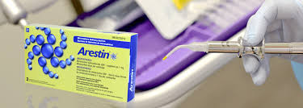
Thank you
ARESTIN is a trademark of Bausch Health Companies Inc. or its affiliates. © 2020 Bausch Health Companies Inc. or its affiliates. ARE.0171.USA.20-Arestin 201 presentation for faculty
Notes:
Read Slide

