Slide 1

101
Periodontal Disease 101:
MANAGING THE
PROGRESSION OF
ADULT PERIODONTITIS
© 2021 Bausch Health Companies Inc. or its affiliates ARE.0182.USA.20 V2.0
Notes:
Today we will discuss the management of periodontal disease.
This presentation was created to further your understanding about the clinical nature of periodontal disease—a bacterial infection that poses specific challenges for treatment. It also explains in detail how a locally administered antibiotic can be used as part of a comprehensive treatment approach for appropriate adult patients when combined with scaling and root planing (SRP).
Finally, we will review some helpful insights and guidance gleaned from extensive patient research to help you speak with patients about their periodontal disease and to help them understand the importance of comprehensive treatment options.

Slide 2

Text PERIO to 96066 to get started
Message and data rates may apply. Text STOP to cancel or HELP for help.
Go to OraPharma.com for terms and privacy conditions.
Notes:
Ask students to sign up.

Slide 3
Objectives
  Discuss the prevalence, risk factors and potential oral health consequences
  of periodontal disease
  Understand the impact of biofilms on the progression of periodontal disease
  Discuss nonsurgical periodontal scaling (commonly known as scaling and root planing (SRP) and the limitations for complete biofilm removal
  Know the benefits and risks of using ARESTIN® (minocycline HCl) Microspheres, 1 mg
  as an adjunct to SRP for the reduction of pocket depth in patients with adult periodontitis
  Recognize the importance of communicating with patients about their periodontal health
  Learn how to administer ARESTIN®
  Understand the safety profile of ARESTIN®
Please see Important Safety Information throughout and full Prescribing Information available at this presentation.
Notes:
Read slide.

Slide 4
ARESTIN® (minocycline HCl) Microspheres, 1 mg
INDICATION
ARESTIN® (minocycline HCl) Microspheres, 1mg is indicated as an adjunct to scaling and root planing (SRP) procedures for reduction of pocket depth in patients with adult periodontitis. ARESTIN® may be used as part of a periodontal maintenance program, which includes good oral hygiene and SRP.
Important Safety Information
ARESTIN is contraindicated in any patient who has a known sensitivity to minocycline or tetracyclines. Hypersensitivity reactions and hypersensitivity syndrome that included, but were not limited to anaphylaxis, anaphylactoid reaction, angioneurotic edema, urticaria, rash, eosinophilia, and one or more of the following: hepatitis, pneumonitis, nephritis, myocarditis, and pericarditis may be present. Swelling of the face, pruritus, fever and lymphadenopathy have been reported with the use of ARESTIN. Some of these reactions were serious. Post-marketing cases of anaphylaxis and serious skin reactions such as Stevens Johnson syndrome and erythema multiforme have been reported with oral minocycline, as well as acute photosensitivity reactions.
THE USE OF DRUGS OF THE TETRACYCLINE CLASS DURING TOOTH DEVELOPMENT MAY CAUSE PERMANENT DISCOLORATION OF THE TEETH, AND THEREFORE SHOULD NOT BE USED IN CHILDREN OR IN PREGNANT OR NURSING WOMEN.
Please see Important Safety Information throughout and full Prescribing Information available at this presentation.
Notes:
Read slide.

Slide 5

Periodontal Disease- Etiologic Factors
Is an infectious Inflammatory disease, driven by certain compositions of bacteria, initiating an inflammatory response
Genetics, environmental and behavioral factors can contribute to the development of the disease
The most common chronic infection in the US is periodontal disease
The most characteristic feature of periodontitis is the activation of osteoclastogenesis and the destruction of alveolar bone
REFERENCE: 1. Könönen, E., Gursoy, M., & Gursoy, U. K. (2019). Periodontitis: A Multifaceted Disease of Tooth-Supporting Tissues. Journal of clinical medicine, 8(8), 1135. doi:10.3390/jcm8081135
Notes:
Periodontal disease in early or moderate stage, with a prevalence of 50% can be managed just as other diseases of the body. It is when the disease progresses to advanced stages, adding other contributing factors it can become harder to control and may lead to tooth loss or other chronic diseases.¹

Slide 6
Periodontitis impacts millions of adults and prevalence increases with age¹
Nearly 3 of every 4 US adults
≥65 y/o²…
Nearly 1 of every 2 US adults
≥30 y/o²…
…are affected by some form of periodontal disease.¹
REFERENCE: 1. Centers for Disease Control and Prevention. Periodontal disease. https://www.cdc.gov/OralHealth/periodontal_disease/. Accessed March 30, 2017.
Notes:
Read slide.

Slide 7

Oral Cavity Microbial Structure
Hundreds of Microbial species in the oral cavity are planktonic (free floating) or incorporated in biofilms¹
As many as 80% of pathogens that form biofilms are associated with persistent infections³
Biofilms are dense mixtures of
organisms resistant to natural
antibodies and proteins that the
body uses to fight infection²
10 million bacteria in a 5 mm pocket
1 billion bacteria 10 mm+ pocket
500 bacterial strains identified in biofilm²
REFERENCES: 1. Berger, D., Rakhamimova, A., Pollack, A., & Loewy, Z. (2018). Oral Biofilms: Development, Control, and Analysis. High-throughput, 7(3), 24. doi:10.3390/ht7030024. 2.Socransky SS, Haffajee AD. Dental biofilms: difficult therapeutic targets. Periodontol 2000 2002;28:12-55. 3. Control of Biofilm Formation: Antibiotics and Beyond, Ammar Algburi, Nicole, Comito, Dimitri Kashtanov, Leon M. T. Dicks, Michael L. Chikindas,M. Julia Pettinari, Editor,DOI: 10.1128/AEM.02508-16.
Notes:
Read slide.

Slide 8
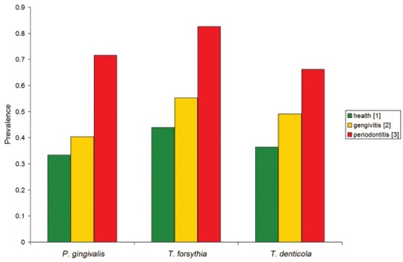
The Microbial Association of Periodontal Disease and Health¹
Research shows specific anaerobic bacteria, called red complex bacteria (RCB), are the main pathogens involved with periodontits.¹
The species that are identified as RCB are:
  P. gingivalis
  T. denticola
  T. forsythia
Prevalence of red complex bacterial species in healthy (green), gingivitis (yellow), and periodontitis (red) patients
REFERENCE: 1. Scapoli, Luca & Girardi, Ambra & Palmieri, Annalisa & Testori, Tiziano & Zuffetti, Francesco & Monguzzi, Riccardo & Lauritano, Dorina & Carinci, Francesco. (2012). Microflora and periodontal disease. Dental research journal. 9. S202-6. 10.4103/1735-3327.109755.
Notes:
The primary microbial factor in periodontitis is a change in the oral microbial flora.
A study of 307 persons, 127 were affected with chronic periodontitis, 66 were health and 144 were affected with moderate gingivitis.
The prevalence of RCB was nearly double in the group affected with periodontitis . This study supports the hypothesis that the presence and amount or RCB is relevant in the diagnosis of periodontitis.

Slide 9
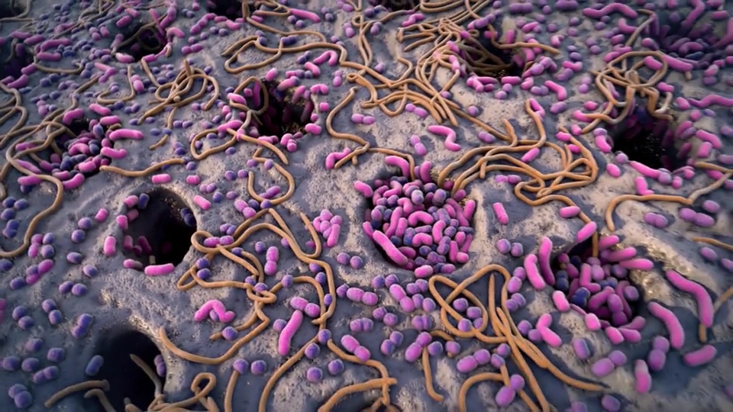
Red Complex Bacteria Increase as PDs Increase¹
PD <4 mm
PD 4-6 mm
PD >6 mm
REFERENCE: 1. Socransky SS, Haffajee AD, Cugini MA, Smith C, Kent RL. Microbial complexes in subgingival plaque. J Clin Periodontol. 1998;25:134-144.
Notes:
Small clusters of RCB along the pocket epithelium are present in pockets of less than 4 mm. As a pocket deepens, these clusters become a band of RCB lining the pocket. At depths of greater than 6 mm, the same band is present, but with an extension of a wide zone of RCB existing in the periodontal pocket.¹
How does periodontal disease progress?
One hypothesis: Deep sites harbor these organisms and act as reservoirs that spread the organisms to the shallow sites.¹
Second hypothesis: Many shallow sites must be colonized before some of those sites progress to become deeper.¹

Slide 10
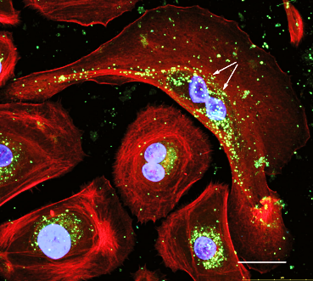
Bacteria are Tissue Invasive
The "red-complex" bacteria are all able to colonize the gingival epithelial cells¹
>100 bacteria observed inside a single gingival epithelial cell²
Image used with permission by Dr. Denise Gay, Naples, Florida
*Includes laser assisted and/or mechanical debridement.
REFERENCES: 1. Thurnheer T, et al. Arch Oral Biol. 2014 Sep;59(9):977-86. doi: Epub 2014 Jun. 2. Mendes, et al. Virulence. 2015 Apr 3;6(3):208-15.
Notes:
Successful control of the initiating biofilm can be challenging. Bacteria are tissue invasive.
Point out the individual gingival epithelial cells, and the green dots which are individual P. gingivalis bacterial cells.
(Read slide)

Slide 11
Non-Surgical Periodontal Treatment
Periodontal therapy (SRP) removes the hard calculus and plaque,
leaving bacteria behind
  Bacteria are tissue invasive and embed into the gum tissue
  The bacteria can enter the bloodstream and travel to other
  parts of the body
  Antibiotics have been useful as adjuncts in the treatment of some
  types of periodontitis
  Helps prevent the bacteria from recolonizing the sulcus¹
Socransky SS, Haffajee AD. Dental biofilms: difficult therapeutic targets. Periodontol 2000. 2002;28:12-55
Goodson JM, Gunsolley JC, Grossi SG, et al. Minocycline HCl microspheres reduce red-complex bacteria in periodontal disease therapy. J Periodontol. 2007;78(8):1568-1579. From: Clinical Manifestations of Periodontal Disease
Notes:
Read slide.

Slide 12
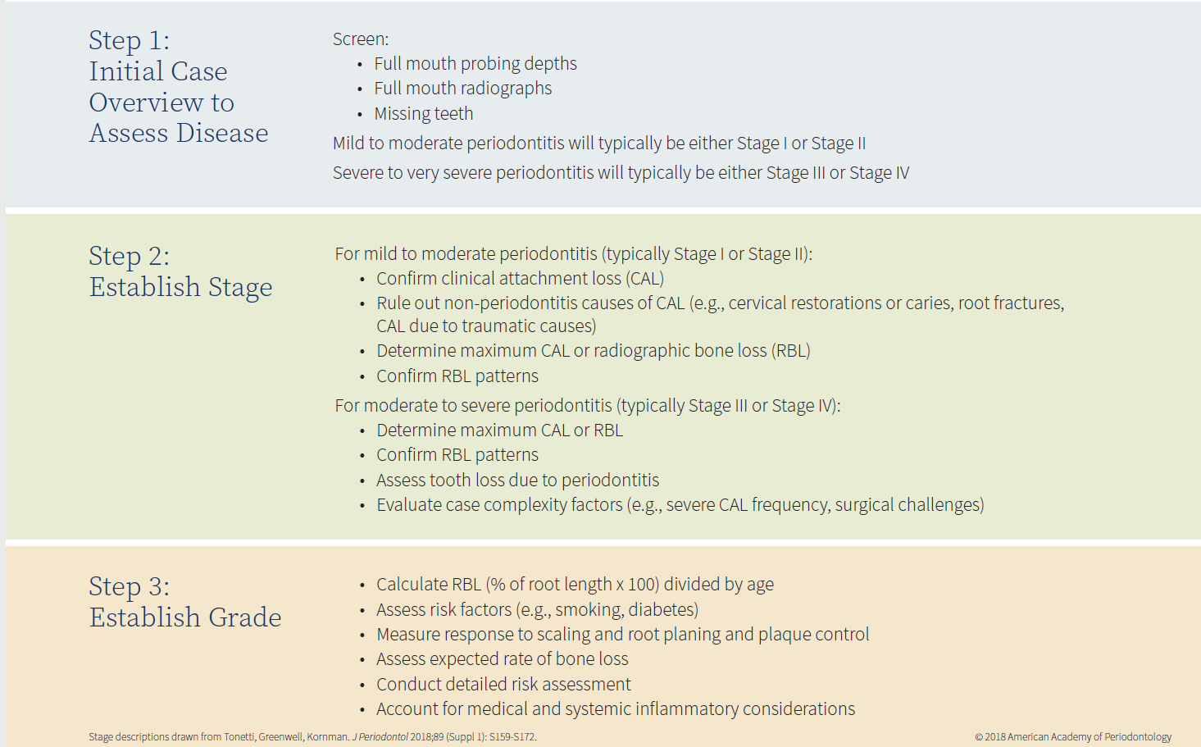
Three Steps to Staging and Grading a Patient
Information from: Caton JG, Armitage G, Berglundh T, Chapple ILC, Jepsen S, Kornman KS, Mealey BL, Papapanou PN, Sanz M, Tonetti MS. A new classification scheme for periodontal and peri-implant diseases and conditions - Introduction and key changes from the 1999 classification. J Periodontol. 2018 Jun;89 Suppl 1:S1-S8. doi: 10.1002/JPER.18-0157.
Notes:
The AAP guidelines describe the severity, extent and progression of periodontal disease. The first step is to assess the disease via a comprehensive periodontal evaluation and charting and full mouth radiographs
Staging and grading of periodontitis is based on the system used in oncology to grade and stage tumors. Staging determines the severity and extent of disease and complexity of management. Grading provides evidence of the rate of progression and the anticipated response to treatment.
Stages I – IV: Increasing severity.
Grades A, B, C: Increasing rate of progression

Slide 13
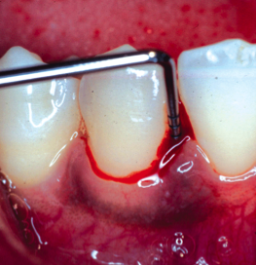
Clinical Periodontal Assessment
Is a detailed fact gathering process that guides the clinical diagnosis of a patient. A comprehensive periodontal charting must be included in this process
Incomplete assessments can lead to undiagnosed or misdiagnosed periodontal disease¹
More than 70% of dental practices do not perform regular full-mouth probing and charting¹
Prophylaxis procedures outnumber SRP procedures by 16 to 1²
Even though radiographs do not show disease activity, they are helpful in detecting early bony changes, bone loss/defects, and furcation involvement¹
REFERENCES: 1. Jill S. Gehrig and Donald E. Willmann 2016. Foundations of Periodontics for the Dental Hygienist, 4th edition . Wolters Kluwer. 2. Levin R. Periodontal profitability. Dental Economics Web site. http://www.dentaleconomics.com/index/display/article-display/173156/articles/dental-economics/volume-93/issue-3/features/periodontal-profitability.html. Published March 1, 2003. Accessed May 28, 2013. 3.. American Dental Association, Survey Center. 2005-06 Survey of Dental Services Rendered. Chicago, IL: American Dental Association; 2007. 4. Data on file. OraPharma. Periodontal disease patient study. Prepared by Olson Research Group, Inc. May 2011.
Notes:
The standard of care in dentistry is to complete a clinical periodontal assessment to include radiographs, visual findings and a comprehensive periodontal charting. If one or any of these are not completed or accurate it could lead to undiagnosed or misdiagnosed periodontal disease.
Despite its prevalence and potentially serious nature, periodontal disease is not being adequately diagnosed or treated today.¹
More than 70% of dental practices do not perform regular full-mouth probing and charting¹—the first step in comprehensive treatment. If periodontal disease is not diagnosed early, then it may not be treated when it could be more easily managed.
According to insurance coding, prophylaxis procedures outnumber SRP procedures by a ratio of 16 to 1—meaning that the disease is largely undertreated.²
Even though radiographs do not show disease activity, they are helpful in detecting early bony changes, bone loss/defects, and furcation involvement.¹
These numbers illustrate the need for more attention in diagnosing and treating periodontal disease and for better patient education.

Slide 14
Focus Points During Patient Assessment
Is there BoP and has it been persistent?
Has probing depth or attachment loss progressed?
Are the probing depths maintainable by the patient and clinician?
Are there any local factors that would hinder mechanical subgingival debridement (furcations, root grooves, concavities, poorly contoured restorations)?
Has the site responded to previous therapy?
Notes:
The following questions can be used to determine stability and the need to treat. (read starting at number 1).

Slide 15
Review Questions

Slide 16
What percentage (%) of Dental Offices Do Not Perform Routine Periodontal Charting?¹
>70%
50%
30%
REFERENCE: 1. Levin R. Periodontal profitability. Dental Economics Web site. http://www.dentaleconomics.com/index/display/article-display/173156/articles/dental-economics/volume-93/issue-3/features/periodontal-profitability.html. Published March 1, 2003. Accessed May 28, 2013.
Notes:
Ask the question.

Slide 17
Correct answer:
(A) More than 70% of dental offices do not
perform routine periodontal charting.¹
REFERENCE: 1. Levin R. Periodontal profitability. Dental Economics Web site. http://www.dentaleconomics.com/index/display/article-display/173156/articles/dental-economics/volume-93/issue-3/features/periodontal-profitability.html. Published March 1, 2003. Accessed May 28, 2013.

Slide 18
Treatment Outcomes
The goal of periodontal therapy is to reduce the infectious and inflammatory challenge and to halt the progression of tissue destruction.
Control of pathogenic biofilms (RCB) and suppression of inflammation can control the periodontal tissue degradation.
Könönen, E., Gursoy, M., & Gursoy, U. K. (2019). Periodontitis: A Multifaceted Disease of Tooth-Supporting Tissues. Journal of clinical medicine, 8(8), 1135. doi:10.3390/jcm8081135
Notes:
Read slide.

Slide 19
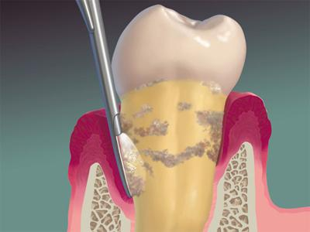
The American Academy of Periodontology (AAP) Stresses periodontal health should be achieved in the least invasive manner ….
Non-surgical therapy also called SRP can accomplish this in appropriate cases BUT it does have its limitations
REFERENCES: https://www.perio.org/consumer/non-surgical-periodontal-treatment
Notes:
While AAP consider SRP the first line of treatment, studies show that it does have its limitations because of the nature of the disease.

Slide 20
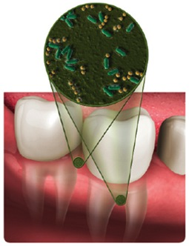
Limitations of Mechanical Therapies¹
Mechanical therapies, such as hand or ultrasonic scaling and laser debridement, cannot completely treat infection¹
Scaling instruments are limited in areas of restricted access and cannot eliminate all periodontal bacteria¹
Following mechanical therapy, bacteria remain, multiply, and can return to baseline levels within days²
Even the most intensive mechanical treatment on its own cannot completely address the bacterial nature of periodontal infection and fully optimize the environment needed for healing³
Deep pockets can restrict access and create a reservoir for bacteria.
Instrumentation does not always reach the furcation region in the depth of the pocket.
REFERENCES: 1. Cobb CM. Non-surgical pocket therapy: mechanical. Ann Periodontol. 1996;1(1):443-490. 2. Socransky SS, Haffajee AD. Dental biofilms: difficult therapeutic targets. Periodontol 2000. 2002;28:12-55. 3. Goodson JM, Gunsolley JC, Grossi SG, et al. Minocycline HCI microspheres reduce red-complex bacteria in periodontal disease therapy. J Periodontol. 2007;78(8):1568-1579.
Notes:
Even after the most diligent SRP, bacteria can remain and continue to replicate. Because the bacteria can reproduce every 4 to 6 hours, they may return to baseline levels within a few days.²
No matter how expert the technique, the instruments used during SRP cannot reach all of the tooth surfaces that harbor bacteria, due to¹:
Furcations
Root flutings
Adjacent teeth in close proximity
Microscopic irregularities in tooth surfaces—especially at the cementoenamel junction
Restorations
In one clinical study, 57% of sites had residual calculus after SRP.¹
We have to ask: Is SRP alone always enough to combat an active periodontal infection?
Can we potentially do more for patients? What additional methods can we employ to make sure we are addressing what we cannot see?

Slide 21

ARE.0029.USA.21
Notes:
Play Limitations of SRP video ARE.0029.USA.21

Slide 22
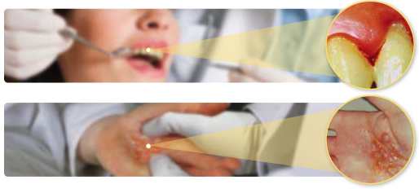
Like Many Other Bacterial Infections, Consider an Antibiotic as Part of Treatment
Patients need to understand that periodontal disease is an active, chronic
bacterial infection¹
Like many other bacterial infections, an antibiotic should be considered
as part of treatment²
REFERENCES: 1. American Academy of Periodontology. Parameter on chronic periodontitis with slight to moderate loss of periodontal support. J Periodontol. 2000;71(5)(suppl):847-883. 2. Williams RC. Medical progress: periodontal disease. N Engl J Med. 1990;322(6):373-380.
Notes:
Make sure patients understand that they have an active, chronic bacterial infection in their mouth that will not go away on its own.¹
It is important for them to understand a periodontal infection is just that—an infection.
Antibiotics are very effective in the treatment of infections, and a bacterial infection should be treated comprehensively.²
An antibiotic should be considered as part of treatment in appropriate patients.²

Slide 23


THE CLINICAL VALUE OF COMPREHENSIVE TREATMENT THAT INCLUDES
ARESTIN® (MINOCYCLINE HCl) MICROSPHERES, 1 MG + SRP
Please see Important Safety Information throughout and full Prescribing Information available at this presentation.
Notes:
Now we will discuss the clinical outcomes associated with a comprehensive treatment plan that includes ARESTIN plus SRP in appropriate patients for PD reduction.

Slide 24
ARESTIN® (minocycline HCl) Microspheres, 1 mg
INDICATION
ARESTIN® (minocycline HCl) Microspheres, 1mg is indicated as an adjunct to scaling and root planing (SRP) procedures for reduction of pocket depth in patients with adult periodontitis. ARESTIN® may be used as part of a periodontal maintenance program, which includes good oral hygiene and SRP.
Important Safety Information
ARESTIN is contraindicated in any patient who has a known sensitivity to minocycline or tetracyclines. Hypersensitivity reactions and hypersensitivity syndrome that included, but were not limited to anaphylaxis, anaphylactoid reaction, angioneurotic edema, urticaria, rash, eosinophilia, and one or more of the following: hepatitis, pneumonitis, nephritis, myocarditis, and pericarditis may be present. Swelling of the face, pruritus, fever and lymphadenopathy have been reported with the use of ARESTIN. Some of these reactions were serious. Post-marketing cases of anaphylaxis and serious skin reactions such as Stevens Johnson syndrome and erythema multiforme have been reported with oral minocycline, as well as acute photosensitivity reactions.
THE USE OF DRUGS OF THE TETRACYCLINE CLASS DURING TOOTH DEVELOPMENT MAY CAUSE PERMANENT DISCOLORATION OF THE TEETH, AND THEREFORE SHOULD NOT BE USED IN CHILDREN OR IN PREGNANT OR NURSING WOMEN.
Please see Important Safety Information throughout and full Prescribing Information available at this presentation.
Notes:
Read slide.

Slide 25
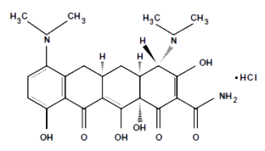
ARESTIN® (minocycline HCl) Microspheres, 1 mg is an antibiotic of the tetracycline family
Minocycline has a broad spectrum of activity
Minocycline is bacteriostatic and exerts its antimicrobial activity by inhibiting protein synthesis
In vitro susceptibility testing has shown that the organisms P. gingivalis, P. intermedia, F. nucleatum, E. corrodens, and A. actinomycetemcomitans, which are associated with periodontal disease, are susceptible to minocycline at concentrations of ≤8 μg/mL.
Qualitative and quantitative changes in plaque microorganisms have not been demonstrated in subjects with periodontitis, using this product.
ARESTIN® (minocycline HCl) Microspheres, 1mg is indicated as an adjunct to scaling and root planing (SRP) procedures for reduction of pocket depth in patients with adult periodontitis. ARESTIN® may be used as part of a periodontal maintenance program, which includes good oral hygiene and SRP.
Please see Important Safety Information throughout and full Prescribing Information available at this presentation.
ARESTIN Prescribing Information. OraPharma, 2017. Goodson J Periodontol. 2007; 78:1568-1579
Notes:
Minocycline, a member of the tetracycline class of antibiotics, has a broad spectrum of activity.
It is bacteriostatic and exerts its antimicrobial activity by inhibiting protein synthesis.
In vitro susceptibility testing has shown that the organisms P. gingivalis, P. intermedia, F. nucleatum, E. corrodens, and A. actinomycetemcomitans, which are associated with periodontal disease, are susceptible to minocycline at concentrations of ≤8 μg/mL; qualitative and quantitative changes in plaque microorganisms have not been demonstrated in subjects with periodontitis, using this product.
ARESTIN® (minocycline HCl) Microspheres, 1mg is indicated as an adjunct to scaling and root planing (SRP) procedures for reduction of pocket depth in patients with adult periodontitis. ARESTIN® may be used as part of a periodontal maintenance program, which includes good oral hygiene and SRP.

Slide 26
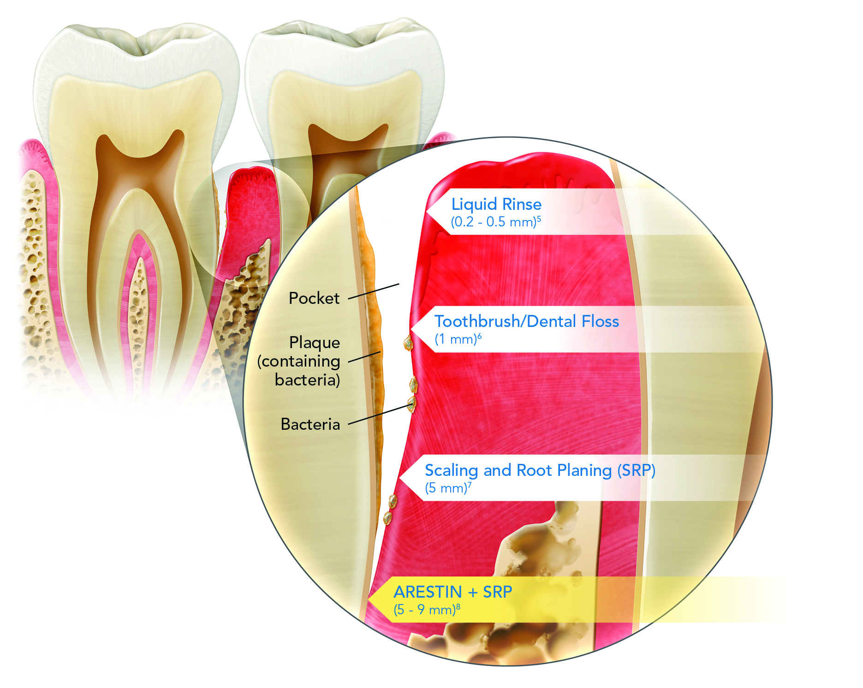
Fight Infection by Going Deep
In a clinical study, ARESTIN + SRP reduced harmful bacteria by nearly 2x as much as SRP alone.^{1-3*}
Adding ARESTIN to SRP disrupts the pathogenic progression of periodontitis by specifically targeting the active infection.⁴
IMPORTANT SAFETY INFORMATION
THE USE OF DRUGS OF THE TETRACYCLINE CLASS DURING TOOTH DEVELOPMENT MAY CAUSE PERMANENT DISCOLORATION OF THE TEETH, AND THEREFORE SHOULD NOT BE USED IN CHILDREN OR IN PREGNANT OR NURSING WOMEN.
*Single-blind, randomized, parallel-group study of 127 patients with moderate-to-severe periodontitis who had at least 5 teeth with ≥5 mm pocket depths. Mean RCB numbers at day 30 were reduced from18.9 x 10⁵ to 9.50 x 10⁵ (50%) by ARESTIN + SRP (P=0.002) and from 19.3 x10⁵ to 14.2 x 10⁵ (26%) by SRP alone (P=0.002).
REFERENCES: 1. Goodson JM, Gunsolley JC, Grossi SG, et al. Minocycline HCl microspheres reduce red-complex bacteria in periodontal disease therapy. J Periodontol. 2007;78(8):1568-1579. 2. Doherty F, Lessem J, Hanlon A, Rose T. Efficacy of Arestin in perio maintenance patients. J Clin Periodontol. 2003;30(suppl 4):abstract. 3. Grossi SG, Goodson JM, Gunsolley JC, et al. Mechanical therapy with adjunctive minocycline microspheres reduces red-complex bacteria in smokers. J Periodontol. 2007;78(9):1741-1750.
4. ARESTIN® (minocycline hydrochloride) Microspheres, 1 mg. Prescribing Information. OraPharma; Horsham, PA: 2017. 5. Pitcher GR, Newman HN, Strahan JD. Access to subgingival plaque by disclosing agents using mouthrinsing and direct irrigation. J Clin Periodontol. 1980;7:300-308. 6. Williams KB, Cobb CM, Taylor HJ, Brown AR, Bray KK. Effect of sonic and mechanical toothbrushes on subgingival microbial flora: A comparative in vivo scanning electron microscopy study of 8 subjects. Quintessence Int. 2001;32(2):147-154. 7. Rabbani GM, Ash MM Jr, Caffesse RG. The effectiveness of subgingival scaling and root planing in calculus removal. J Periodontol. 1981;52(3):119-123. 8. Williams RC, Paquette DW, Offenbacher S, et al. Treatment of periodontitis by local administration of minocycline microspheres: a controlled trial. J Periodontol. 2001;72(11):1535-1544.
Please see Important Safety Information throughout and full Prescribing Information available at this presentation.
Notes:
In a single-blind, 3-arm clinical study of 748 patients with moderate-to-advanced periodontitis, it was shown that ARESTIN + SRP was more effective at targeting bacteria at 5-9 mm PD than SRP alone. Pivotal trials were conducted in patients with PDs of 5-9 mm. These trials are included in the ARESTIN PI.
Important Safety Information
The use of drugs of the tetracycline class during tooth development may cause permanent discoloration of the teeth, and therefore should not be used in children or in pregnant or nursing women.

Slide 27

American Academy of Periodontology
Recommendations
Clinical Situation | Recommendation
Treatment Procedures | Chemotherapeutic agents may be used as appropriate to reduce, eliminate, or change the quality of microbial pathogens, or to alter the host response through local or systemic delivery.
Periodontal Maintenance Therapy | Local delivery of systemic chemotherapeutic agents may be used as adjunctive treatment for recurrent or refractory disease.
1. AAP. J Periodontol. 2011;82:943-994.
Please see Important Safety Information throughout and full Prescribing Information available at this presentation.
Notes:
Talking Points
In its 2011 statement, Comprehensive Periodontal Therapy, the AAP recommends the following:
Under “Treatment Procedures:” When indicated, chemotherapeutic agents may be used as appropriate to reduce, eliminate, or change the quality of microbial pathogens, or to alter the host response through local or systemic delivery
Under “Periodontal Maintenance Therapy:” Local delivery of systemic
chemotherapeutic agents may be used as adjunctive treatment for recurrent or refractory disease
Reference
American Academy of Periodontology. Comprehensive periodontal therapy: a statement by the American Academy of Periodontology. J Periodontol. 2011;82:943-949.
27

Slide 28
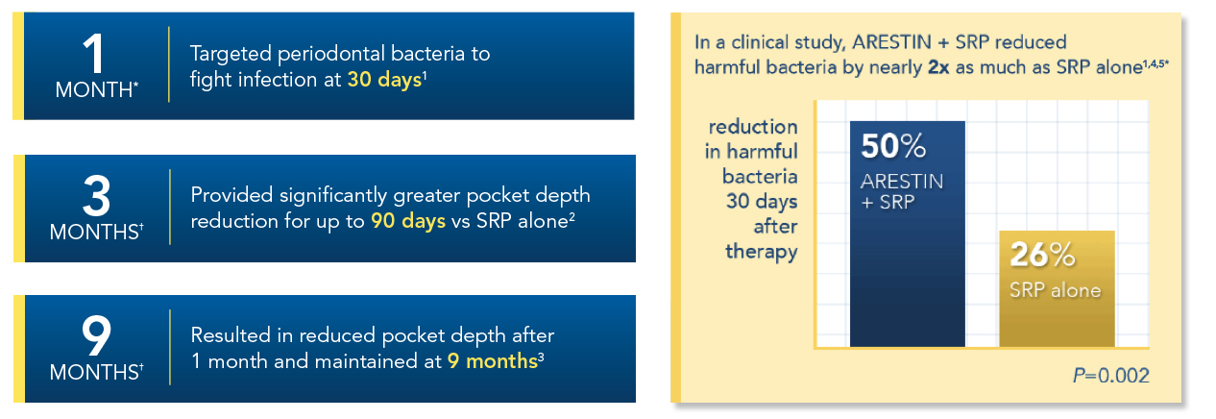
Why Consider ARESTIN® (minocycline HCl) Microspheres, 1 mg?
When incorporated into a routine oral maintenance program along with SRP, ARESTIN:
The effects of ARESTIN on microorganism overgrowth have not been studied beyond 6 months.
*Single-blind, randomized, parallel-group study of 127 patients with moderate-to-severe periodontitis who had at least 5 teeth with ≥5 mm pocket depths. Mean RCB numbers were reduced from 18.9 x 10⁵ to 9.50 x 10⁵ (50%) by ARESTIN + SRP and from 19.3 x 10⁵ to 14.2 x 10⁵ (26%) by SRP alone.
†In 2 multicenter, investigator-blind, parallel-design studies of 748 patients with generalized moderate-to-advanced adult periodontitis characterized by a mean probing depth of
5.90 mm and 5.81 mm, subjects received 1 of 3 treatments: (1) SRP, (2) SRP + vehicle, and (3) SRP + ARESTIN. Retreatment occurred at 3 and 6 months after initial treatment, and any new site with pocket depth ≥5 mm also received treatment. Patients treated with ARESTIN were found to have statistically significantly reduced probing pocket depth compared with those treated with SRP alone or SRP + vehicle at 9 months after initial treatment. ARESTIN vs SRP alone (n=250) P<0.01; ARESTIN vs vehicle + SRP (n=249) P<0.001; ARESTIN + SRP vs vehicle (n=249) P<0.001. To qualify for the studies, subjects were required to have 4 teeth with periodontal pockets of 6 to 9 mm that bled on probing. However, treatment was administered to all sites with mean probing depths of 5 mm or greater. Subjects studied were in good general health. Subjects with poor glycemic control or active infectious diseases were excluded from the studies.
REFERENCES: 1. Goodson JM, Gunsolley JC, Grossi SG, et al. Minocycline HCl microspheres reduce red-complex bacteria in periodontal disease therapy. J Periodontol. 2007;78(8):1568-1579. 2. Williams RC, Paquette DW, Offenbacher S, et al. Treatment of periodontitis by local administration of minocycline microspheres: a controlled trial.
J Periodontol. 2001;72(11):1535-1544. 3. ARESTIN® (minocycline hydrochloride) Microspheres, 1 mg. Prescribing Information. OraPharma; Horsham, PA: 2017. 4. Doherty F, Lessem J, Hanlon A, Rose T. Efficacy of Arestin in perio maintenance patients. J Clin Periodontol. 2003;30(suppl 4):abstract. 5. Grossi SG, Goodson JM, Gunsolley JC, et al. Mechanical therapy with adjunctive minocycline microspheres reduces red-complex bacteria in smokers. J Periodontol. 2007;78(9):1741-1750.
Please see Important Safety Information throughout and full Prescribing Information available at this presentation.
Notes:
Research has shown that patients can experience improvement in PD reduction when ARESTIN is used as an adjunct to SRP versus SRP alone, when indicated. However, the effects of ARESTIN on microorganism overgrowth have not been studied beyond six months.³
Let’s look at the following slides to compare how ARESTIN plus SRP performed vs SRP alone in large clinical studies. To qualify for the studies, subjects were required to have 4 teeth with periodontal pockets of 6 to 9 mm that bled on probing. However, treatment was administered to all sites with mean probing depths of 5 mm or greater. Subjects studied were in good general health. Subjects with poor glycemic control or active infectious diseases were excluded from the studies.

Slide 29
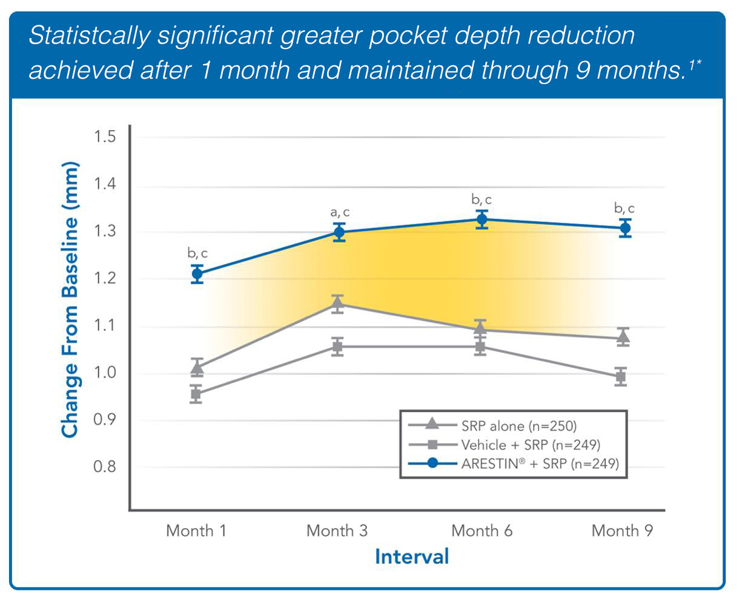
Clinical Information
IMPORTANT SAFETY INFORMATION
ARESTIN® (minocycline HCl) Microspheres, 1 mg is contraindicated in any patient who has a known sensitivity to minocycline or tetracyclines. Hypersensitivity reactions and hypersensitivity syndrome that included, but were not limited to anaphylaxis, anaphylactoid reaction, angioneurotic edema, urticaria, rash, eosinophilia, and one or more of the following: hepatitis, pneumonitis, nephritis, myocarditis, and pericarditis may be present. Swelling of the face, pruritus, fever and lymphadenopathy have been reported with the use of ARESTIN. Some of these reactions were serious. Post-marketing cases of anaphylaxis and serious skin reactions such as Stevens Johnson syndrome and erythema multiforme have been reported with oral minocycline, as well as acute photosensitivity reactions.
*Subpopulation of combined, single-blind, Phase III trials comparing ARESTIN + SRP to SRP alone and SRP + placebo (n=748). SRP was performed for all groups at baseline. ARESTIN or vehicle was administered to periodontal pockets ≥5 mm in the adjunctive therapy groups at baseline, 3 months, and 6 months. Efficacy was evaluated over 9 months.
REFERENCE: 1. Williams RC, Paquette DW, Offenbacher S, et al. Treatment of periodontitis by local administration of minocycline microspheres: a controlled trial. J Periodontol. 2001;72(11):1535-1544.
Please see Important Safety Information throughout and full Prescribing Information available at this presentation
Notes:
In clinical trials, when ARESTIN was used as an adjunct to SRP, statistically significant PD reduction was achieved after 1 month and maintained through 9 months.
ARESTIN® (minocycline HCl) Microspheres, 1 mg is contraindicated in any patient who has a known sensitivity to minocycline or tetracyclines. Hypersensitivity reactions and hypersensitivity syndrome that included, but were not limited to anaphylaxis, anaphylactoid reaction, angioneurotic edema, urticaria, rash, eosinophilia, and one or more of the following: hepatitis, pneumonitis, nephritis, myocarditis, and pericarditis may be present. Swelling of the face, pruritus, fever and lymphadenopathy have been reported with the use of ARESTIN. Some of these reactions were serious. Post-marketing cases of anaphylaxis and serious skin reactions such as Stevens Johnson syndrome and erythema multiforme have been reported with oral minocycline, as well as acute photosensitivity reactions.

Slide 30
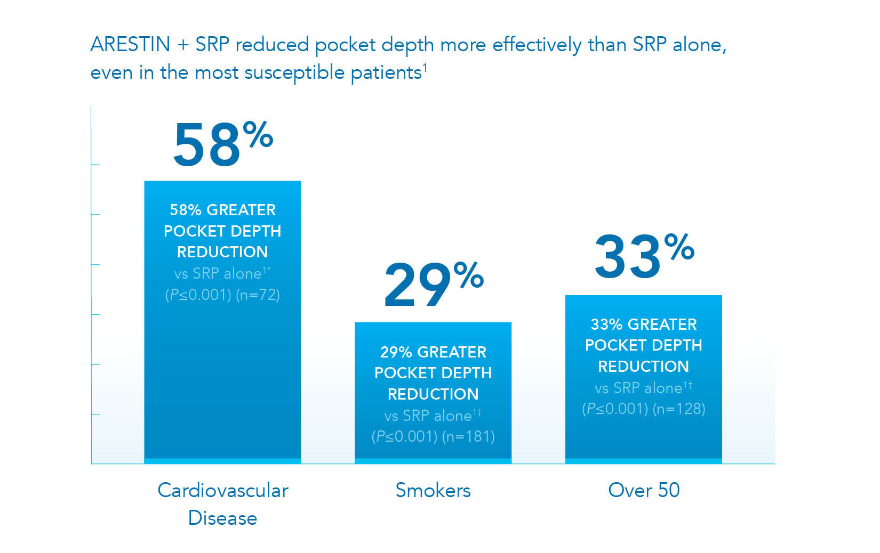
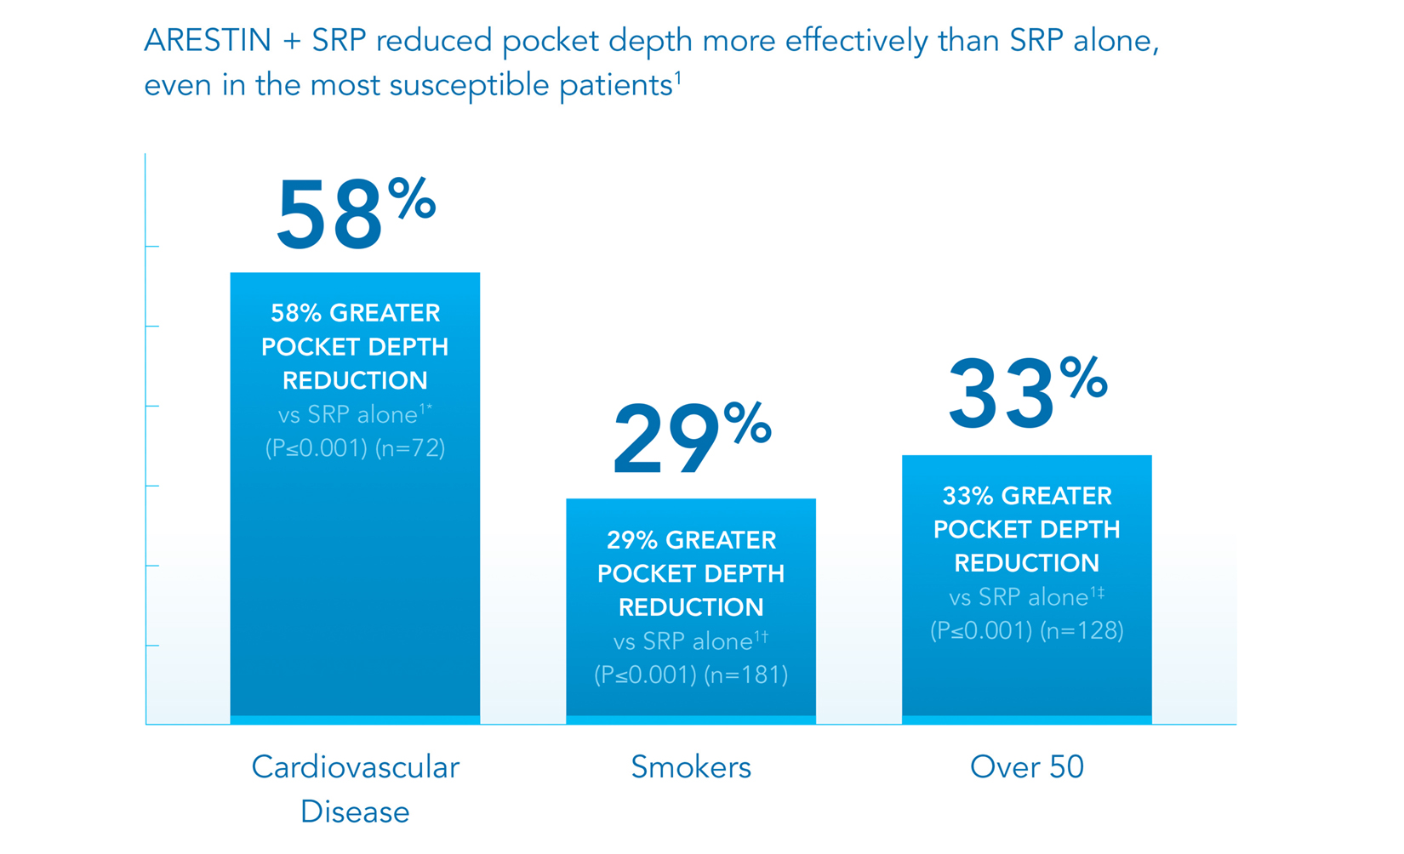
Use of ARESTIN® (minocycline HCl) Microspheres, 1 mg in Patients with Existing Conditions and Other Risk Factors
IMPORTANT SAFETY INFORMATION
In clinical trials, the most frequently reported nondental treatment-emergent adverse events were headache, infection, flu syndrome, and pain.
*Subpopulation (n=101) of combined single-blind, Phase III trials comparing ARESTIN + SRP to SRP alone and SRP + placebo (n=748). SRP was performed for all groups at baseline. ARESTIN or vehicle was administered to periodontal pockets ≥5 mm in the adjunctive therapy groups at baseline, 3 months, and 6 months. Efficacy was evaluated over 9 months. At 9 months, ARESTIN + SRP had a 58% greater therapeutic effect vs SRP alone in periodontal patients with cardiovascular disease (P≤0.001).
†Subpopulation (n=271) of combined, single-blind, Phase III trials comparing ARESTIN + SRP to SRP alone and SRP + placebo (n=748). SRP was performed for all groups at baseline. ARESTIN or vehicle was administered to periodontal pockets ≥5 mm in the adjunctive therapy groups at baseline, 3 months, and 6 months. Efficacy was evaluated over 9 months. At 9 months, ARESTIN + SRP had a 29% greater therapeutic effect vs SRP alone in smokers (P≤0.001).
‡Subpopulation (n=109) of combined, single-blind, Phase III trials comparing ARESTIN + SRP to SRP alone and SRP + placebo (n=748). SRP was performed for all groups at baseline. ARESTIN or vehicle was administered to periodontal pockets ≥5 mm in the adjunctive therapy groups at baseline, 3 months, and 6 months. Efficacy was evaluated over 9 months. At 9 months, ARESTIN + SRP had a 33% greater therapeutic effect vs SRP alone in patients over the age of 50 (P≤0.001).
REFERENCE: 1. ARESTIN® (minocycline hydrochloride) Microspheres, 1 mg. Prescribing Information. OraPharma; Horsham PA: 2017.
Please see Important Safety Information throughout and full Prescribing Information available at this presentation
Notes:
It is important to recognize how ARESTIN combined with SRP can reduce PD in appropriate patients with certain conditions or other risk factors. Let’s look at the examples here.
IMPORTANT SAFETY INFORMATION
In clinical trials, the most frequently reported nondental treatment-emergent adverse events were headache, infection, flu syndrome, and pain.

Slide 31
ARESTIN® (minocycline HCl) Microspheres, 1 mg
Important Safety Information
Tetracyclines, including oral minocycline, have been associated with development of autoimmune syndromes including a lupus-like syndrome manifested by arthralgia, myalgia, rash, and swelling. Sporadic cases of serum sickness-like reaction have presented shortly after oral minocycline use, manifested by fever, rash, arthralgia, lymphadenopathy and malaise. In symptomatic patients, diagnostic tests should be performed and ARESTIN treatment discontinued.
The use of ARESTIN in an acutely abscessed periodontal pocket or for use in the regeneration of alveolar bone has not been studied.
Please see Important Safety Information throughout and full Prescribing Information available at this presentation
Notes:
Read slide.

Slide 32
ARESTIN® (minocycline HCl) Microspheres, 1 mg
Important Safety Information
The safety and effectiveness of ARESTIN has not been established in immunocompromised patients or in those with coexistent oral candidiasis. Use with caution if there is a predisposition to oral candidiasis.
In clinical trials, the most frequently reported nondental treatment-emergent adverse events were headache, infection, flu syndrome, and pain.
To report SUSPECTED ADVERSE REACTIONS, contact Bausch Health US, LLC at 1-800-321-4576 or FDA at 1-800-FDA-1088 or www.fda.gov/medwatch.
Please see Important Safety Information throughout and full Prescribing Information available at this presentation
Notes:
Read slide.

Slide 33

.
HOW TO ADMINISTER
ARESTIN® (MINOCYCLINE HCI)
MICROSPHERES, 1 MG
Please see Important Safety Information throughout and full Prescribing Information available at this presentation
Notes:
Now we will discuss how to administer ARESTIN.

Slide 34
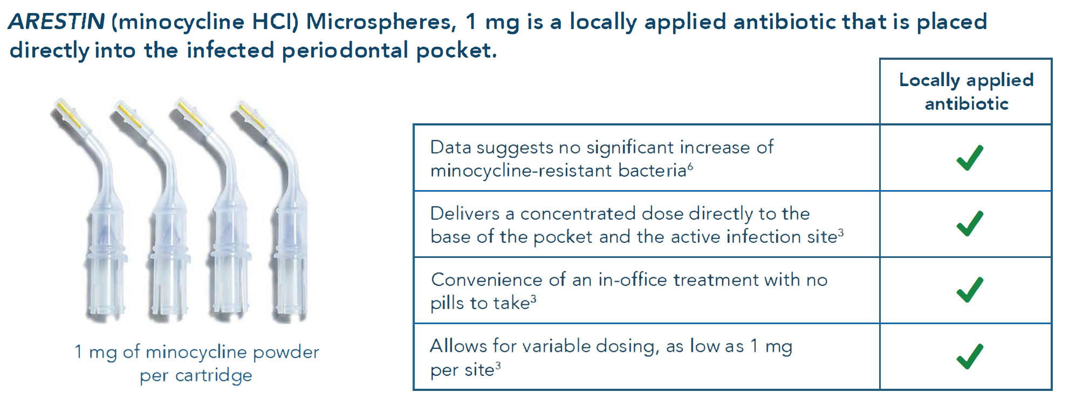
Benefits of a locally applied antibiotic
Please see Important Safety Information throughout and full Prescribing Information available at this presentation
Notes:
Read slide.
Pre-filled cartridges, containing 1 mg of minocycline Microspheres, are used to place ARESTIN at the base of the infected periodontal pocket at the time of SRP. This delivers a concentrated dose of antibiotic directly to the active infection site.¹

Slide 35
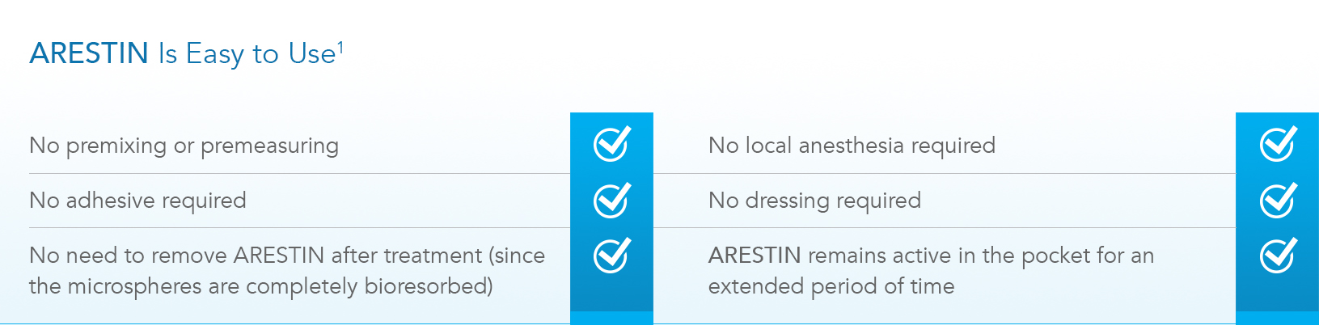
Administering ARESTIN® (minocycline HCl) Microspheres, 1 mg
Delivery system: microspheres—effective delivery and easy to use
ARESTIN allows for easy, targeted placement at the base of the periodontal pocket.¹ Once inserted in the pocket, ARESTIN microspheres immediately adhere to the surrounding surfaces, providing a sustained release of minocycline at the site of active infection.^{1,2}
REFERENCES: 1. ARESTIN® (minocycline hydrochloride) Microspheres, 1 mg. Prescribing Information. OraPharma; Horsham, PA: 2017. 2. Williams RC, Paquette DW, Offenbacher S, et al. Treatment of periodontitis by local administration of minocycline microspheres: a controlled trial. J Periodontol. 2001;72(11):1535-1544.
Please see Important Safety Information throughout and full Prescribing Information available at this presentation
Notes:
ARESTIN allows for easy, targeted placement at the base of the periodontal pocket. Once inserted in the pocket, ARESTIN Microspheres immediately adhere to the surrounding surfaces, providing a sustained release of minocycline at the site of active infection.^{1,2}
ARESTIN is also both bioadhesive and bioresorbable, which means that it sticks to the site and there is no need to remove the product from the site.¹

Slide 36
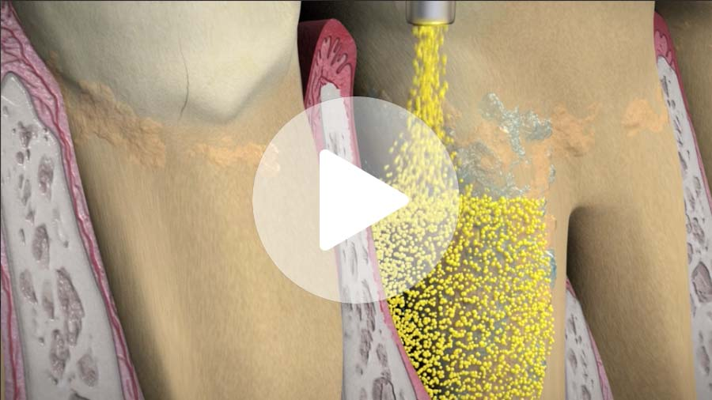
How to Administer ARESTIN® (minocycline HCl) Microspheres, 1 mg
To view the video, visit ArestinProfessional.com/resource-library
Please see Important Safety Information throughout and full Prescribing Information available at this presentation
Notes:
Now let’s watch a short video on how to administer ARESTIN.

Slide 37
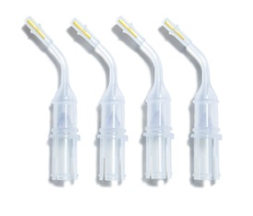
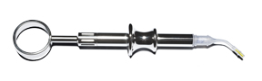
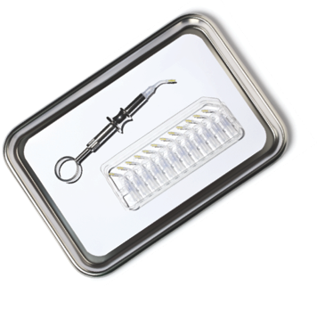
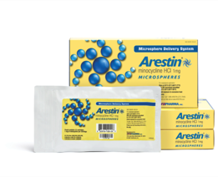
ARESTIN Delivery System
REFERENCE: 1. ARESTIN® (minocycline hydrochloride) Microspheres, 1 mg. Prescribing Information. OraPharma; Horsham, PA: 2017.
Please see Important Safety Information throughout and full Prescribing Information available at this presentation
Notes:
ARESTIN is administered by a stainless steel handle and attachable cartridges that each contain 1 mg of minocycline HCl Microspheres.¹
The ARESTIN cartridge includes a container, a plunger that expels the powder, and a small cap that fits over the tip of the cartridge.

Slide 38
Educational Tools for periodontal disease
Notes:
Read Slide

Slide 39


Help Patients Understand Treatment for Periodontal Disease
Indication
Gum disease is caused by an active and persistent bacterial infection¹
ARESTIN® (minocycline HCl) Microspheres, 1 mg is indicated as an adjunct to scaling and root planing (SRP) procedures for reduction of pocket depth in patients with adult periodontitis. ARESTIN® may be used as part of a periodontal maintenance program, which includes good oral hygiene and SRP.
Non-surgical therapy , called scaling and root planing (SRP), is the gold standard to treat gum disease²
Important Safety Information
ARESTIN® (minocycline HCl) Microspheres,
1 mg is a locally applied adjunctive antibiotic that is placed directly at the site of infection to help target the harmful bacteria associated with gum disease³
ARESTIN® is contraindicated in any patient who has a known sensitivity to minocycline or tetracyclines. Hypersensitivity reactions have been reported with its use. Post-marketing cases of anaphylaxis and serious skin reactions such as Stevens Johnson syndrome and erythema multiforme have been reported with oral minocycline, as well as acute photosensitivity reactions
When used with a nonsurgical treatment, ARESTIN is clinically proven to reduce pocket depth and keeps working after you leave the dental office⁴
Discuss consequences of not treating periodontal disease ⁶
Please see Important Safety Information throughout and full Prescribing Information available at this presentation
Discuss the risks of antibiotic treatment⁵
Notes:
Talking Points
Once patients understand periodontal disease and its serious consequences if left untreated, it is important for them to understand their treatment plan. As we discussed, patients respond to messaging that gum disease is caused by an active and persistent bacterial infection.¹ Non surgical therapy, and you may want to mention that is also called SRP—scaling and root planing (in case they are inclined to do some research on their own)—is necessary to treat gum disease.²
Tell your patients that ARESTIN in addition to SRP is a locally applied antibiotic that is placed directly at the site of infection to help target the harmful bacteria associated with gum disease.³ When used along with the required treatment to remove the bacteria, ARESTIN is clinically proven to reduce pocket depth, and keeps working after they leave the dentist office.⁴
Important Safety Information
ARESTIN® (minocycline HCl) Microspheres, 1 mg is indicated as an adjunct to scaling and root planing (SRP) procedures for reduction of pocket depth in patients with adult periodontitis. ARESTIN® may be used as part of
a periodontal maintenance program, which includes good oral hygiene and SRP.
Please note that ARESTIN has the indication ( speaker to read indication -
Please also note that ARESTIN has
contraindications ( speaker to read the entire contraindication)
ARESTIN® is contraindicated in any patient who has a known sensitivity to minocycline or tetracyclines. Hypersensitivity reactions have been reported with its use. Post-marketing cases of anaphylaxis and serious skin reactions such as Stevens Johnson syndrome and erythema multiforme have been reported with oral minocycline, as well as acute photosensitivity reactions

Slide 40
Notes:
Tell patients these easy-to-use instructions to ensure that they have the best chance for successful clinical outcomes after they’ve been treated with ARESTIN. These instructions are also found in the Prescribing Information packaged with ARESTIN.

Slide 41
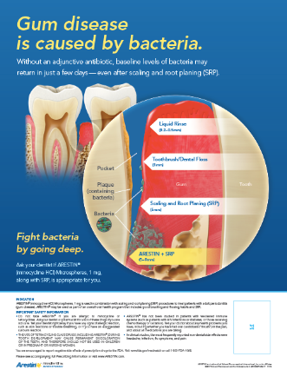
Patient resources to Choose ARESTIN® (minocycline HCl) Microspheres, 1 mg
Indication
ARESTIN® (minocycline HCl) Microspheres, 1 mg is indicated as an adjunct to scaling and root planing (SRP) procedures for reduction of pocket depth in patients with adult periodontitis. ARESTIN® may be used as part of a periodontal maintenance program, which includes good oral hygiene and SRP.
Important Safety Information
ARESTIN® is contraindicated in any patient who has a known sensitivity to minocycline or tetracyclines. Hypersensitivity reactions have been reported with its use. Post-marketing cases of anaphylaxis and serious skin reactions such as Stevens Johnson syndrome and erythema multiforme have been reported with oral minocycline, as well as acute photosensitivity reactions
Patient resources available:
Arestin.com
Education Card Display Easel
Patient Brochure
Patient Posters
Notes:
Talking Points
There are many resources available to help you clearly and easily communicate the benefits of ARESTIN to your patients; including the website, a take-home patient brochure, and in-office materials, such as the educational easel and patient posters. We can review how to get these materials at the end of the presentation.
ARESTIN® is contraindicated in any patient who has a known sensitivity to minocycline or tetracyclines. Hypersensitivity reactions have been reported with its use. Post-marketing cases of anaphylaxis and serious skin reactions such as Stevens Johnson syndrome and erythema multiforme have been reported with oral minocycline, as well as acute photosensitivity reactions
THE USE OF DRUGS OF THE TETRACYCLINE CLASS DURING TOOTH DEVELOPMENT MAY CAUSE PERMANENT DISCOLORATION OF THE TEETH, AND THEREFORE SHOULD NOT BE USED IN
CHILDREN OR IN PREGNANT OR NURSING WOMEN.
■ Tetracyclines, including oral minocycline, have been associated with development of autoimmune syndromes including a lupus-like syndrome manifested by arthralgia, myalgia, rash, and swelling. Sporadic cases of serum sickness-like reaction have presented shortly after oral minocycline use, manifested by fever, rash, arthralgia, lymphadenopathy and malaise. In symptomatic patients,
diagnostic tests should be performed and ARESTIN treatment discontinued.

Slide 42
Frequently Asked Questions
What is the maximum number of cartridges that can be used on a patient?
In US clinical trials, up to 122 unit-dose cartridges were used in a single visit, and up to 3 treatments, at 3-month intervals, were administered in pockets with pocket depth of 5 mm or greater, with an average of 30 sites per patient.¹
How much minocycline is in each tip of ARESTIN® (minocycline HCl) Microspheres, 1 mg?
Each unit-dose cartridge delivers minocycline hydrochloride equivalent to 1 mg of minocycline.¹
How often can ARESTIN be placed?
ARESTIN is a subgingival sustained-release product containing the antibiotic minocycline hydrochloride incorporated into a bioresorbable polymer. ARESTIN will remain in the pocket for an extended period of time where it targets the bacteria that cause periodontal disease. In clinical trials, ARESTIN was administered in pockets 5 mm or greater at baseline, at 3 months and at 6 months. However, the clinician should use their professional judgment to determine the diagnosis and treatment plan that is in the best interest of the patient. The effects of treatment for greater than
6 months have not been studied.¹
What are the most commonly reported side effects of ARESTIN?
The most frequently reported nondental treatment-emergent adverse events in the 3 multicenter US trials were headache, infection, flu syndrome, and pain.
Can ARESTIN be used at the initial SRP appointment as well as at maintenance? The effects of treatment for greater than 6 months have not been studied.
Yes, this is consistent with our indication.¹
REFERENCE: 1. ARESTIN® (minocycline HCl) Microspheres, 1 mg. Prescribing Information. OraPharma; Horsham, PA: 2017.
Notes:
Please note the answers to these frequently asked questions about ARESTIN.

Slide 43
Thank you
ARESTIN and OraPharma are trademarks of Bausch Health Companies Inc. or its affiliates.
© 2021 Bausch Health Companies Inc. or its affiliates. ARE.0182.USA.20 V2.0
Notes:
Thank you for your participation in our program discussing the management of periodontal disease.

